Slide 1
Calorimetry
What is it? How does it connect to our energy bars?

Slide 2
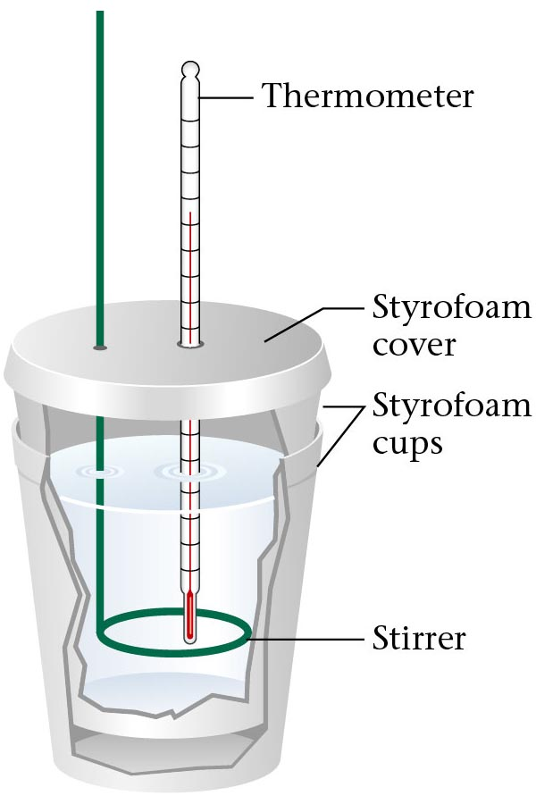
What is Calorimetry?
You just used a very simple calorimeter!
The transfer of heat between the system and surroundings
Thermometer
Styrofoam
cover
Styrofoam
cups
Stirrer
www.teachnlearnchem.com

Slide 3
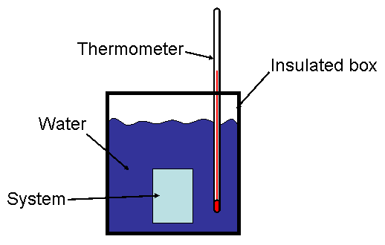
How do we Measure “Heat”?
Discuss with your partner what measurements we took.
What variables did we use during our experiment?
chemlab.truman.edu

Slide 4
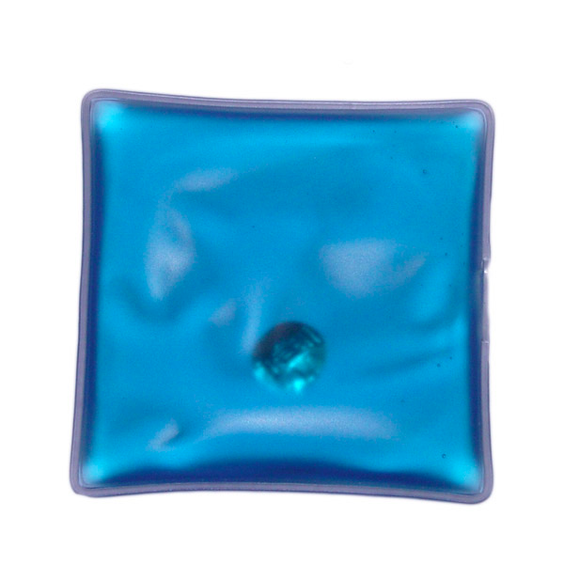
Mass
Why did we take measurements before and after for our mass?
What function did that difference in mass perform?
What about the mass of the water? What the difference between the mass of the hand warmer and mass of the water?
www.joyiqi.com

Slide 5
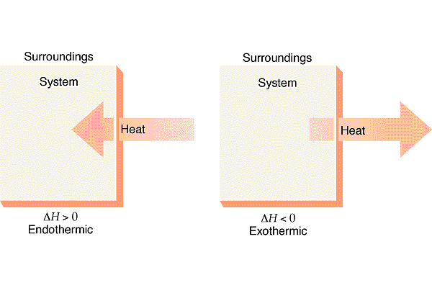
Temperature
What happened to the temperature of the water? Why?
Endothermic Reactions: Reactions in which energy is absorbed as the reaction proceeds
Exothermic Reactions: Reactions in which energy is released as the reaction proceeds
lechemistryblog.blogspot.com

Slide 6
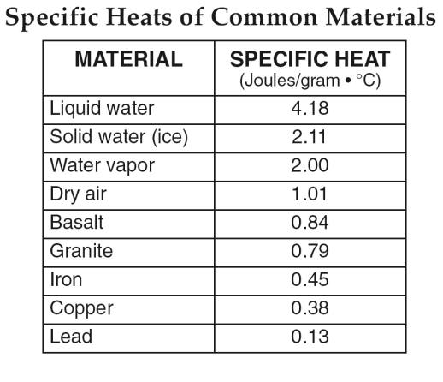
Specific Heat
It requires 4.18 Joules of energy to heat 1 g of water 1°C
Water will heat up slowly and requires a lot of energy and copper will cool off quickly and not release much energy
http://www.regentsearth.com/

Slide 7
But what about Heat?
*
*mass of the water, in our case

Slide 8
Energy Bars
Heat is measured in “Joules”, or “J”
Because this is just a form of energy, we can convert this to “Calories”
wps.prenhall.com

Slide 9
Calculations
Calculate the amount of heat produced by the hand warmers in your notebook (the specific heat of water is 4.18 J°C/g)

